Slide 1
Virtualization in 5G
NFV and SDN are essential in 5G networks to reduce costs and bring added value to network infrastructure.
NFV is the process of moving/forwarding tasks such as load balancing, firewalls, and so on away from dedicated hardware into a virtualized environment.
NFV enables the execution of software-based network function on general purpose hardware by leveraging virtualization techniques.
The virtualization technologies allow breakup of the software of network functions from dedicated hardware.
Softwarization allows implementation of network functions in software, including virtualization of such functions and programmability by setting appropriate interfaces.

Slide 2
Virtualization in 5G
It is an approach to use software programming to design, implement, and maintain network equipment and services.
In SDN, the control plane is decoupled from the data plane and is managed by a logically centralized controller that has a holistic view of the network.
Softwarization in RAN may allow some functions such as PDCP and RRC to be implemented as VNFs.
Softwarization can also be used to implement certain core and transport functions.
The original aim of combining NFV and SDN was to decouple services from physical resources allowing flexibility and adaptability in the network.

Slide 3
Virtualization in 5G
When NFV and SDN come together, they provide the additional benefit of detaching lifecycle management from physical constraints.
Network slice, as discussed in last class, It supports the connectivity of a particular use case through a collection of 5G network functions, and specific configurations in RAN, transport, and core networks.
Network functions provide connectivity, storage, and computation.
Finally, 5G is not all about connectivity, but also demands high end computation and storage.
Computation and storage requirements also vary among the different network areas and elements.

Slide 4
Virtualization in 5G
The 5GS embraces Network Function virtualization (NFV) and cloudification for its architecture design.
The 5GS supports different virtualization deployment scenarios, such a
– A Network Function instance can be deployed as fully distributed, fully redundant, stateless, and fully scalable NF instance that provides the services from several locations and several execution instances in each location.
– A Network Function instance can also be deployed such that several network function instances that are present within a NF set are fully distributed, fully redundant, stateless, and scalable as a set of NF instances.
The network slicing feature supported by 5GS is also enabled by the virtualization.
Network function instances can be created, instantiated, and isolated with each other in the virtualized environment, into different network slices in order to serve different services

Slide 5
Virtualization in 5G
In order to manage the life cycle of the virtualized 5GS functions and its instances as well as the virtual resource of network slice, 5G OAM provides means to integrate with virtualized network function management and orchestration capability, as well as providing standardized life cycle management interfaces with other virtualized function management and orchestration system which are defined by other standards, such as ETSI ISG NFV, and other open source project, such as ONAP.

Slide 6
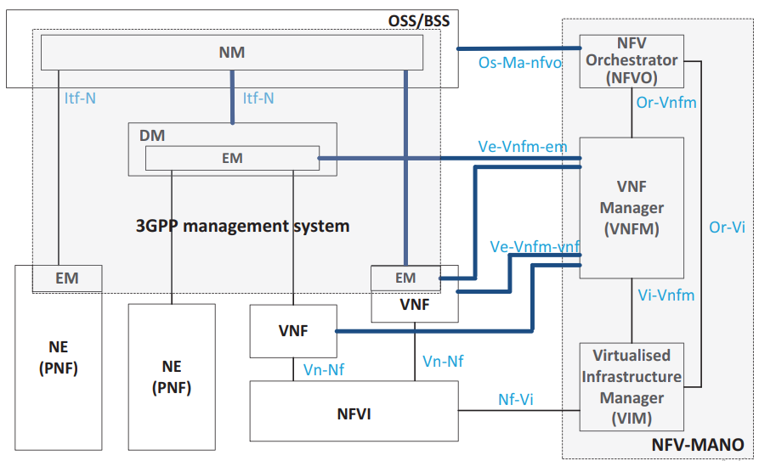
Virtualization in 5G

Slide 7
Virtualization in 5G
Figure illustrates the integration of 5G OAM system with ETSI NFV management and orchestration (MANO) system.
In this illustration, 5G management system provides the 5G service and functionality management, such as NM plays one of the roles of OSS/BSS and provides the functions for the management of mobile network which includes virtualized network functions; and EM/DM is responsible for FCAPS management functionality for a VNF on an application level and physical NE on a domain and element level.
ETSI ISG NFV MANO provides the virtualized resource and life cycle management for those virtualized 5G functions and the network service and network slice composed by those functions

Slide 8
Edge Computing
Edge computing is an emerging computing paradigm which refers to a range of networks and devices at or near the user.
Edge is about processing data closer to where it’s being generated, enabling processing at greater speeds and volumes, leading to greater action-led results in real time.
It offers some unique advantages over traditional models, where computing power is centralized at an on-premise data center.
Putting compute at the edge allows companies to improve how they manage and use physical assets and create new interactive, human experiences.
Some examples of edge use cases include self-driving cars, autonomous robots, smart equipment data and automated retail.
https://www.accenture.com/in-en/insights/cloud/edge-computing-index#:~:text=Edge%20computing%E2%80%94or%20just%20%E2%80%9Cedge,as%20possible%20to%20data%20sources.

Slide 9
Edge Computing
Possible components of edge include:
Edge devices:
Network edge:
On-premises infrastructure:
https://www.accenture.com/in-en/insights/cloud/edge-computing-index#:~:text=Edge%20computing%E2%80%94or%20just%20%E2%80%9Cedge,as%20possible%20to%20data%20sources.

Slide 10
Edge Computing
Possible components of edge include: 1. Edge devices:
We already use devices that do edge computing every day—like smart speakers, watches and phones – devices which are locally collecting and processing data while touching the physical world.
Internet of Things (IoT) devices, point of sales (POS) systems, robots, vehicles and sensors can all be edge devices—if they compute locally and talk to the cloud.
https://www.accenture.com/in-en/insights/cloud/edge-computing-index#:~:text=Edge%20computing%E2%80%94or%20just%20%E2%80%9Cedge,as%20possible%20to%20data%20sources.

Slide 11
Edge Computing
Possible components of edge include: 2. Network edge:
Edge computing doesn’t require a separate “edge network” to exist (it could be located on individual edge devices or a router, for example).
When a separate network is involved, this is just another location in the continuum between users and the cloud and this is where 5G can come into play.
5G brings extremely powerful wireless connectivity to edge computing with low latency and high cellular speed, which brings exciting opportunities like autonomous drones, remote telesurgery, smart city projects and much more.
The network edge can be particularly useful in cases where it is too costly and complicated to put compute on premises and yet high responsiveness is required (meaning the cloud is too distant).
https://www.accenture.com/in-en/insights/cloud/edge-computing-index#:~:text=Edge%20computing%E2%80%94or%20just%20%E2%80%9Cedge,as%20possible%20to%20data%20sources.

Slide 12
Edge Computing
Possible components of edge include: 3. On-premises infrastructure:
These are for managing local systems and connecting to the network and could be servers, routers, containers, hubs or bridges.
https://www.accenture.com/in-en/insights/cloud/edge-computing-index#:~:text=Edge%20computing%E2%80%94or%20just%20%E2%80%9Cedge,as%20possible%20to%20data%20sources.

Slide 13
Edge Computing
Edge computing is considered a key technology for efficient routing to application servers hosted by the operator or a third party to achieve low latency as well as efficient use of the transport network.
In the context of 3GPP, the Edge Computing refers to the scenarios where the services need to be hosted close to the access network of the UE (e.g., at or close to the RAN).
As described earlier, in 5GS the routing of the data (or user) traffic is done via UPF interface to a Data Network.
The 5G core network supports the capability to select a UPF that allows routing of traffic to a local Data Network that is close to the UE’s access network.
This includes the local breakout scenarios for roaming UEs as well as non-roaming scenarios.

Slide 14
Edge Computing
The decision for selection (or reselection) of UPF for local routing may be based on the information from an Edge Computing Application Function (AF) and/or to other criteria such as the subscription, location, and policies.
Depending on the operator’s policy and arrangements with the third parties, an AF may access the 5G core directly or indirectly via the Network Exposure Function (NEF).
For example, an external AF at the edge data center could influence the routing of the traffic by altering the SMF routing decisions via its interaction with the Policy Control Function (PCF).

Slide 15
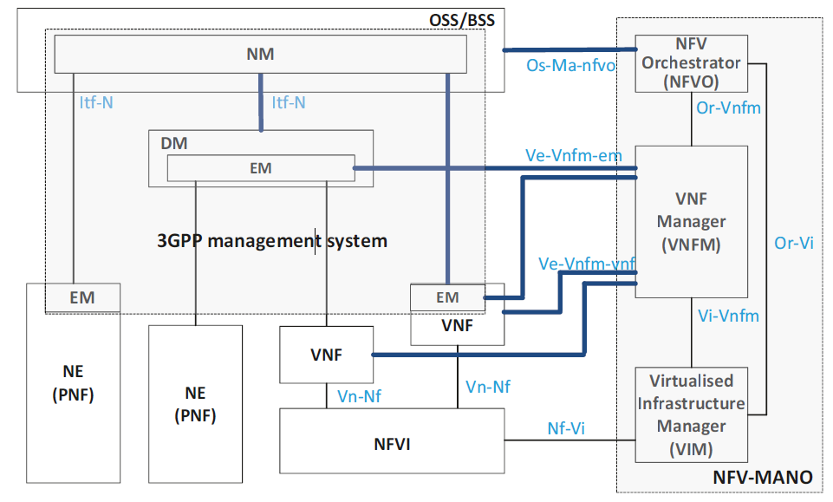
Edge Computing

Slide 16
Edge Computing
The figure shows local and central data networks (DN) that a UE can reach for edge compute services.
In this example, each of the UEs (UE1–3) requests the SMF to establish PDU sessions with a central and local anchor.
The SMF establishes UPF anchor (PSA-0) as the central anchor for each of the PDU sessions, but they each have different UPF PSA for session breakout since the aim is to breakout to a local N6 network that is proximate to the edge application server (EAS).

Slide 17
Edge Computing
Edge computing is considered a key technology for efficient routing to application servers hosted by the operator or a third party to achieve low latency as well as efficient use of the transport network.
In the context of 3GPP, the Edge Computing refers to the scenarios where the services need to be hosted close to the access network of the UE (e.g., at or close to the RAN).
As described earlier, in 5GS the routing of the data (or user) traffic is done via UPF interface to a Data Network.
The 5G core network supports the capability to select a UPF that allows routing of traffic to a local Data Network that is close to the UE’s access network.
This includes the local breakout scenarios for roaming UEs as well as non-roaming scenarios.

Slide 18
Edge Computing
For end-to-end QoS and other service guarantees (reliability, protection, etc.), the PDU session segment and the N6 segment to the application server are important to manage.
3GPP-specified QoS with URLLC considers the PDU session segment.
For the N6 segment, IP routing and transport network underlays with SD-WAN, MPLS, TSN, or other means of providing reliable service guarantees is necessary.
If the PDU session segment and the N6 segments are operated by different providers (e.g., MNO, IP transport provider, application service provider) there needs to be coordination to support end-to-end guarantees

Slide 19
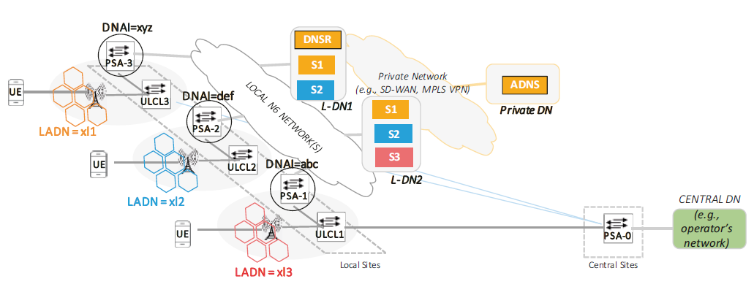
Edge Computing
Another concept introduced in 5G standards to support routing to application data networks (DN) based on the origin/location of the request from the UE. This is shown in Figure.

Slide 20
Edge Computing
The UE is configured with LADN (Local Area Data Network) information on a per PLMN basis for 3GPP accesses.
LADN Service Area applies to a set of tracking areas (TA) of PLMN and is configured in AMF and is only accessible by the UE at those specific locations.
An LADN DNN (Data Network Name) corresponds to an LADN service that the UE is configured with during registration.
Location-based selection and direction of application data packets is facilitated by LADN.
For example, in the figure above, there are three LADN (xl1, xl2, xl3) comprising of a set of TAs (some of which may overlap).
A UE that registers and is configured to use these sets of services (S1, S2, S3).
Each of these sets may consist of applications that can only be accessed from a DNAI (Data Network Access Identifier).

Slide 21
Edge Computing

Slide 22
Mobile Edge Computing
A data network (DN) where applications are located is identified by a DNAI.
For example, UEs with LADN xl1 is allowed to access the set of services in S1 via DNAI = xyz.
Route filters in ULCL perform access filtering to limit access to only authorized sessions.

Slide 23
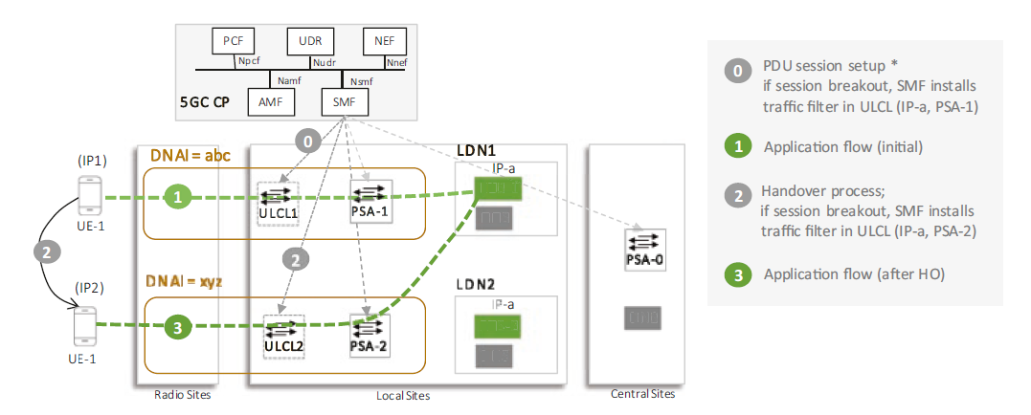
Mobile Edge Computing
For stateful applications and UE mobility (new IP access/DNAI), it results in selecting a new LDN (Local Data Network).
The UE continues to be served by the old LDN location where its data is stored. In the figure, after the PDU session is set up (step 0), the UE is served by EAS-1 in the local data network (step 1). After handover (step 2), the UE continues to be served by EAS-1 (step 3).

Slide 24
Mobile Edge Computing
The rationale is that not all UE mobility requires application server relocation.
It may be that the current application server is close enough, or that closer application servers may be overloaded.
The application domain orchestrator determines the appropriate change of application server based on UE mobility, but also managing congestion, site outage, mitigation of DDoS attacks, and other administrative policy.
The application domain may also decide to move the serving application server for a variety of reasons.
The trigger may be that following handover, the UE is better served by a closer server, but the change of application server may be initiated to balance application load, handle server failure, or comply with domain policies on transit cost.

Slide 25
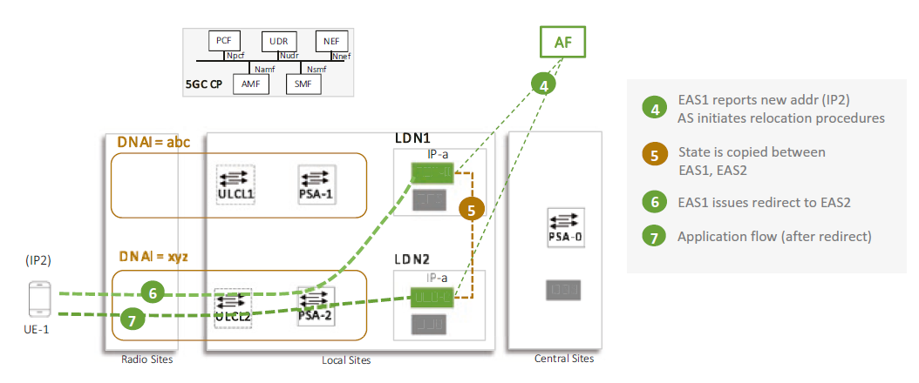
Mobile Edge Computing
Figure shows an overview of possible steps to achieve the relocation of application server.
3GPP procedures also describe application server relocation using AF influenced routing.
In this case, the AF coordinates both PDU session and application server relocation.

Slide 26
Mobile Edge Computing
When the application domain orchestrator (AF in figure) determines that the server should be relocated based on IP address change or other criteria (step 4), it selects the new server (EAS2).
The old server (EAS1) and new server (EAS2) replicate state (step 5) for the UE during this transition.
The old server (EAS1) then sends an application layer redirect request, e.g., HTTPS redirect (step 6) to the new server (EAS2).
The UE has the URL translated and initiates application message to EAS2 (step 7), and the replication of state across EAS1/EAS2 is stopped.
Thus, PDU session relocation and application relocation can both be accomplished with minimum coordination.

Slide 27
Mobile Edge Computing
Engineered backhauls and IP transport along with new protocols such as QUIC enable a good end-to-end QoS during this transition by using zero RTT application session establishment capability.

Slide 28
Mobile Edge Computing (MEC)
Multi-access edge computing (MEC), formerly mobile edge computing, is an ETSI-defined network architecture concept
MEC enables cloud computing capabilities and an IT service environment at the edge of the cellular network and, more in general at the edge of any network.
The basic idea behind MEC is that by running applications and performing related processing tasks closer to the cellular customer, network congestion is reduced and applications perform better.
MEC technology is designed to be implemented at the cellular base stations or other edge nodes, and enables flexible and rapid deployment of new applications and services for customers.
Combining elements of information technology and telecommunications networking, MEC also allows cellular operators to open their radio access network (RAN) to authorized third parties, such as application developers and content providers.
https://en.wikipedia.org/wiki/Multi-access_edge_computing#:~:text=Article%20Talk,the%20edge%20of%20any%20network.

Slide 29
Quality of Service Requirements
Quality of service (QoS) requirements are technical specifications that specify the system quality of features such as performance, availability, scalability, and serviceability.
System Quality | Description
Performance | The measurement of response time and throughput with respect to user load conditions.
Availability | A measure of how often a system’s resources and services are accessible to end users, often expressed as the uptime of a system.
Scalability | The ability to add capacity (and users) to a deployed system over time. Scalability typically involves adding resources to the system but should not require changes to the deployment architecture
Security | A complex combination of factors that describe the integrity of a system and its users. Security includes authentication and authorization of users, security of data, and secure access to a deployed system
Latent capacity | The ability of a system to handle unusual peak loads without additional resources. Latent capacity is a factor in availability, performance, and scalability qualities.
Serviceability | The ease by which a deployed system can be maintained, including monitoring the system, repairing problems that arise, and upgrading hardware and software components.
https://docs.oracle.com/cd/E19636-01/819-2326/gaxqg/index.html#:~:text=Quality%20of%20service%20(QoS)%20requirements,specified%20in%20the%20business%20requirements.

